Slide 1
DATA ANALYTICS · CASE STUDY
From 3,900 transactions
to actionable customer insight
A customer shopping behavior analysis that connects preparation, analysis, and business decisions.
Python · PostgreSQL · SQL · Power BI

Slide 2
PROJECT AT A GLANCE
The project connects data preparation to business decisions
One workflow moved from raw purchases to a decision-ready view of customer behavior.
01
02
03
04
Python
PostgreSQL
SQL
Power BI
Cleaned the data and engineered features.
Loaded the prepared dataset for analysis.
Answered business questions about customers and products.
Turned findings into an interactive dashboard.
3,900
18
4
purchases analyzed
columns
product categories
02

Slide 3
01 · DATA PREPARATION
Reliable analysis started with disciplined data preparation
01
02
03
Profile
Standardize
Engineer & load
Loaded and profiled the dataset with pandas, df.info(), and describe().
Imputed 37 missing review ratings using category medians and standardized columns to snake case.
Engineered age_group and purchase_frequency_days, checked discount and promo-code redundancy, and loaded the cleaned data into PostgreSQL.
03

Slide 4
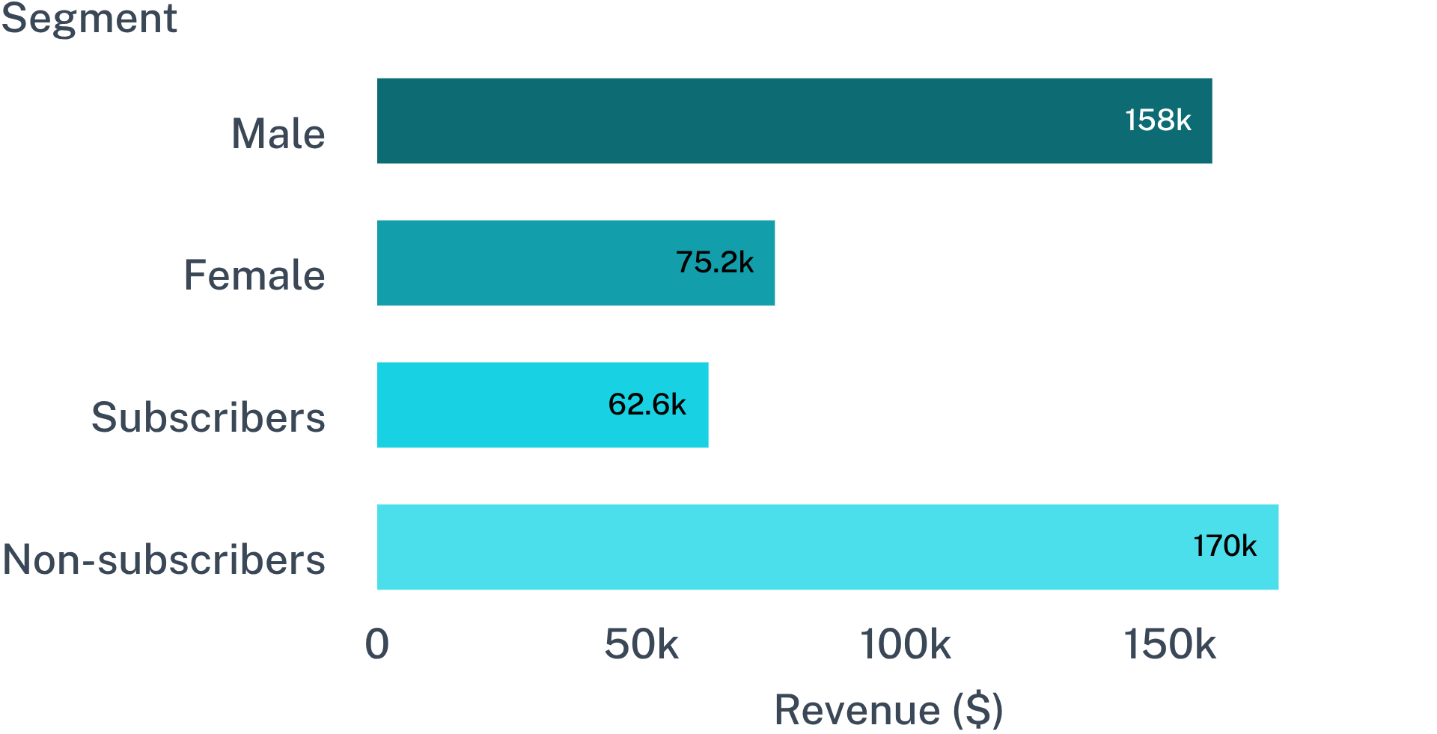
02 · CUSTOMER ECONOMICS
Revenue is concentrated in male customers, while subscriptions remain a growth gap
27%
73%
Subscribers
Non-subscribers
Subscribers represented 27% of customers; non-subscribers represented 73%.
Revenue: $157,890 from male customers versus $75,191 from female customers. Total revenue was $62,645 from subscribers versus $170,436 from non-subscribers.
Revenue by gender and subscription status
04

Slide 5
03 · CUSTOMER SEGMENTS
Loyal customers dominate the base, but discount behavior needs attention
Loyal
Returning
New
3,116
701
83
customers
customers
customers
High-value discount use
Discount-dependent products
839 customers used discounts while spending above the average purchase amount.
Hats led at 50.00%, followed by sneakers at 49.66% and coats at 49.07%.
05

Slide 6
04 · PRODUCT & SERVICE SIGNALS
Product and service signals point to clear merchandising opportunities
Top-rated products
Shipping signal
Top-selling products
3.86
$60.48
Jewelry, sunglasses, belts, blouses, pants, shirts, sandals, shoes, sneakers, jackets, and coats across categories.
Gloves lead, followed by sandals 3.84, boots 3.82, hats 3.80, and skirts 3.78.
Average express-shipping order versus $58.46 for standard shipping.
06

Slide 7
05 · DECISION-READY OUTPUT
The dashboard turns analysis into a decision-ready view
Customers
Average purchase
Average review
3.9K
$59.76
3.75
HIGHEST REVENUE AGE GROUP
DECISION LENS
$62,143
Explore the gap
Power BI makes the findings easier to explore, compare, and explain.
Use filters to connect customer segments, products, subscriptions, and shipping behavior.
Young adults
Interactive views cover subscription status, gender, category, shipping type, revenue, sales, and age group.
07

Slide 8
DECISION TAKEAWAY
What I would recommend next
01
02
03
Boost subscriptions
Reward repeat buyers
Balance discount and margin
Use exclusive benefits and stronger conversion messaging.
Move more customers into the loyal segment.
Review discount policy, promote top-rated products, and focus targeting on high-revenue age groups.
The analysis ends with choices the business can act on.

